Slide 1
Radio-Frequency Identification Operating Pet Doors
Raddath Juhuri (EE)
Nada Sharaf (EE)
David Ifesanya (EE)
Advisors: Professor Leonid Tsybeskov
: Professor Marek Sosnowski
ECE Senior Design Project Workshop December 11, 2018

Slide 2
Project Objective: The major goal of our project is to provide comfort and safety for pets, pet owners and the home alike. This is accomplished by opening the door only for the specific pet whenever it is within a certain range away from the door. It also prevents other animals from entering the house and causing harm to the pets or the owner through diseases that can be the transmitted or damaging the properties within the house. Project Significance: This project is important because it helps pets feel less uncomfortable when they are home alone when the owner is at work or not around. Exercise is very useful and important for the growth and development of a pet, but most pets don’t get enough exercise because they are indoors all day. Project Novelty: Due to the fact that we are using Radio Frequency communication which isn’t available on the market and also the ability to send notifications to users whenever the door open, our project is more unique to the ones on the market at the moment.

Slide 3
Approach
Our project primarily consists and revolves around two sensors; a RFID module and three IR proximity sensors. Two solenoids would also be used for our project to act as a lock for the door, one solenoid outside and the other would be in the house. The RFID module would also be attached to the outer part of the door while we have the three sensors are attached to the inner part of the door. The RFID module reads the tag around the pet’s collar then activates the inner solenoid allowing the animal entry into the house. For exiting the house, whenever the pet walks to the door, one or more IR sensor picks up the pet’s movement and activates the outer solenoid allowing the animal to push the flap and exit the house.

Slide 4
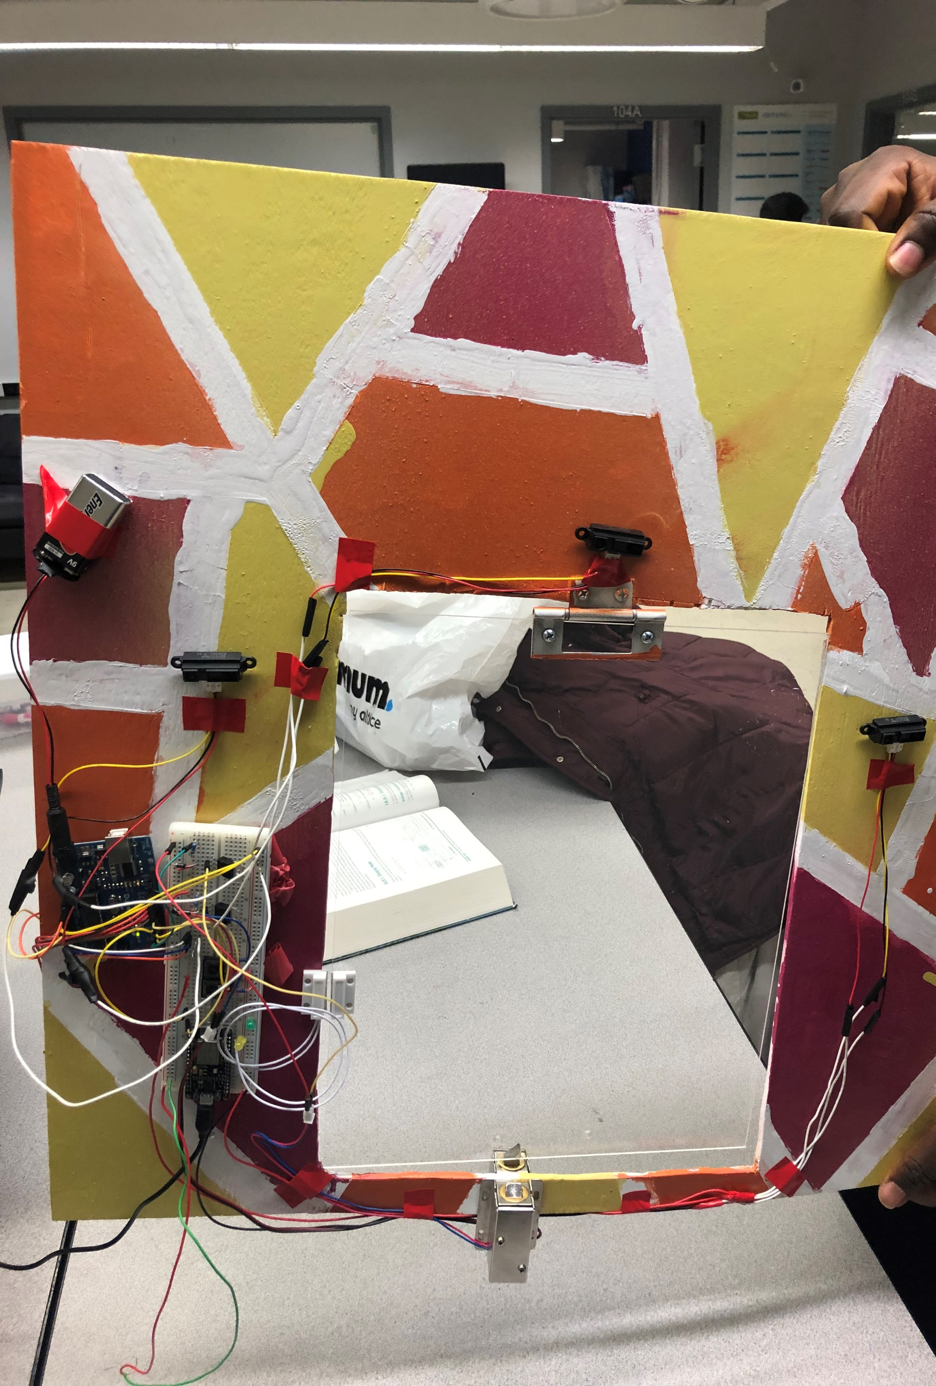
Picture of the inner part of the door with components attached
Solenoid
3 proximity sensors
Arduino
Wifi module – ESP 8266
Door Sensor

Slide 5
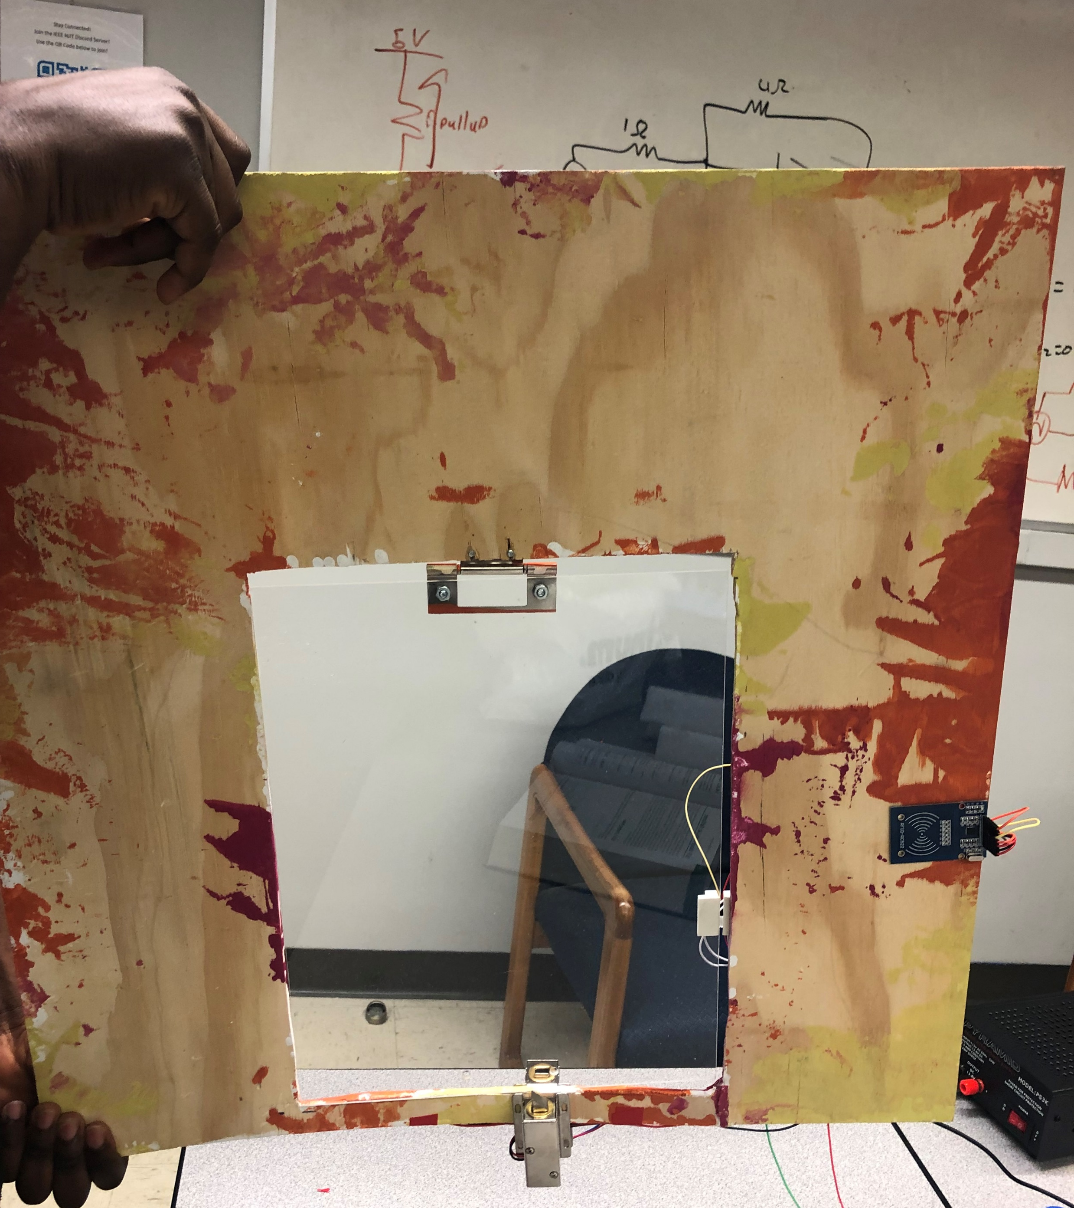
Picture of the outer part of the door with components attached
RFID module
Solenoid

Slide 6
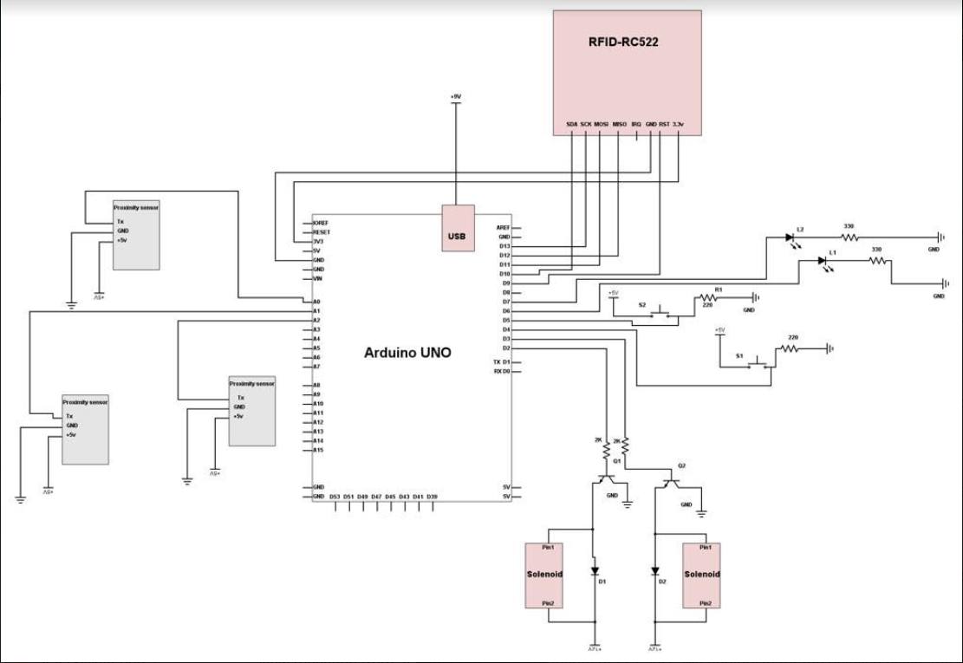
Project Schematics

Slide 7
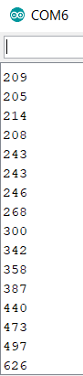
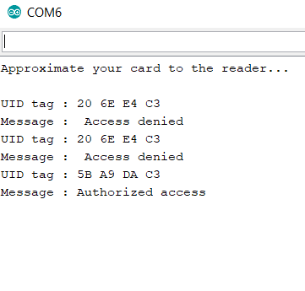
Measurements and Testing
Readings taking from one IR proximity sensor
Readings taking from the RFID module interacting with 2 different tags

Slide 8
Specifications
The range of the RFID antenna is approximately 10 mm, but we planned to increase the range by using an external antenna.
The range of the IR proximity sensors are about 1-2 inches.
We will be using a 9V battery to power up the Arduino and a 12V power supply to power the solenoids.

Slide 9
Budgets
Component | Qty | Price
Solenoid Lock | 2 | $24.10
Proximity sensor | 3 | $38.97
Arduino UNO | 1 | $28.00
Plexiglass | 1 | $52.00
RFID tag and reader (module) | 1 | $6.99
Resistors (200kΩ, 220Ω, 330Ω) | 6 | $1.00
Diode | 2 | $0.50
Darlington Transistor | 2 | $7.49
HiLetgo Wi-Fi Module | 1 | $8.39
Wired Door Sensor | 1 | $5.66
12V Power Supply | 1 | $33.31
9V Power Supply | 1 | $12.99
Wood | 1 | $5
Total Cost |  | $224.40

Slide 10
Learning Experience and Obstacles
Learning Experience
Working on this project gave us a lot of insight on how Arduino works and establishing a connection with other components.
Our main problem before the start of this project was the fact that none of us knew much or anything about coding but now we are able to write codes for different scenarios.
Obstacles
We had problems figuring out the best way to extend the range on the RFID signal.
It was also difficult hiding all the wires but it would have been much easier if we had a thicker board. That way we would have been able to hide the wires inside the wood and pass the across to wherever we need the components placed.

Slide 11
Future Potential
Our product design is more technologically developed than other similar products that are available in the market. Our product would be a great addition to commercial product because all pet lovers and owners would want to buy a product that would keep their pets safe. Pet owners would prefer our product mainly because users can keep track of their pet’s movement which other available products cannot.

Slide 12
References
Instructables. “Controlling Solenoids With Arduino.” Instructables.com, Instructables, 5 Nov. 2017, www.instructables.com/id/Controlling-solenoids-with-arduino/.
Instructables. “RFID Cat Door.” Instructables.com, Instructables, 3 Nov. 2017, www.instructables.com/id/RFID-cat-door/.
“Mifare MFRC522 RFID Reader/Writer.” Arduino Playground - WhatAdapter, playground.arduino.cc/Learning/MFRC522.

Slide 13
Acknowedegments
We would like to express our sincere gratitude to our supervisors; Professor Leonid Tsybeskov, for helping to perfect the idea during the ECE 414 class, and Professor Marek Sosnowski, for the constant encouragement to find even better ways to improve on our project during the ECE 416 class.
We would also like to thank our friends; Smit Shah and Christopher Migdalski for being there for us whenever we needed advice. Special thanks to Wesley Scott for his assistance in the physical design of the project and Bryam Loaiza for helping with the coding. This is also dedicated to our families who supported us during the entire process. Thank you all.

Slide 14
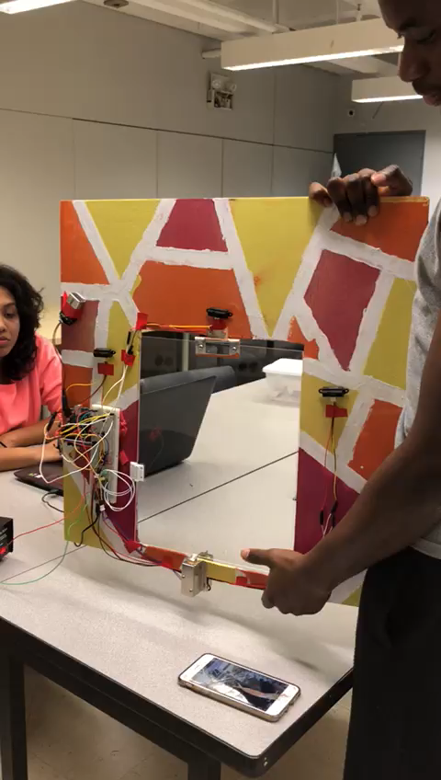
Demonstration

Slide 15
Thank you.

